Slide 1
Model Evaluation
Linden Lu

Slide 2
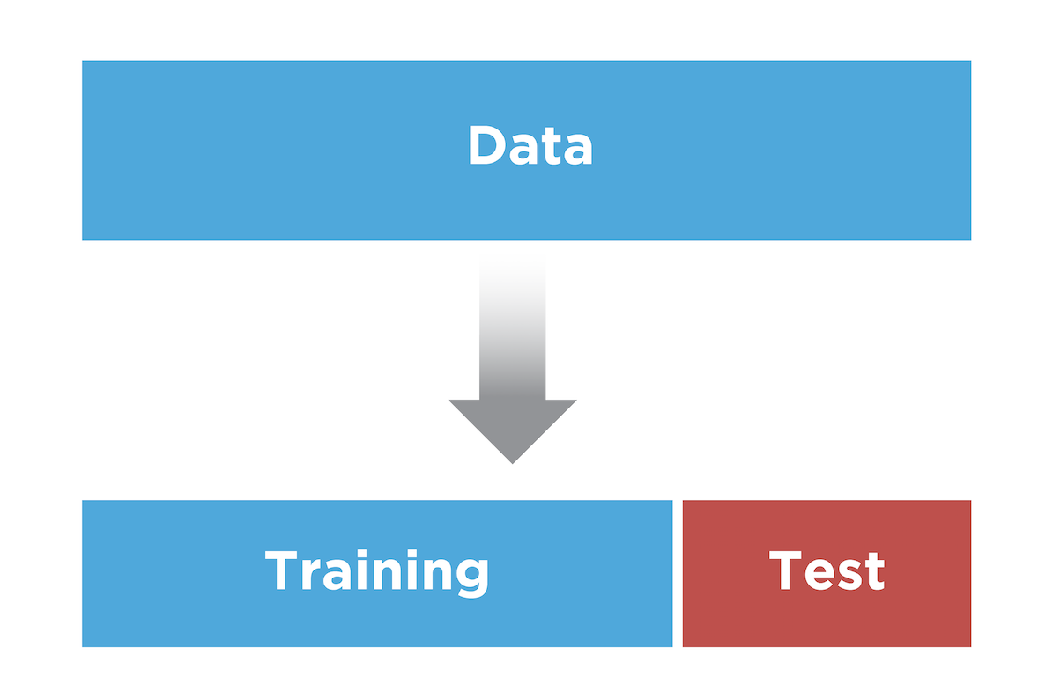
Dataset Splitting

Slide 3

CRISP-DM
© 2012 Kenneth Jensen / CC BY-SA 3.0 / http://tinyurl.com/yxuuhnyx

Slide 4
Model Evaluation
Regression evaluation metrics
Classification evaluation metrics
Case study

Slide 5
Regression Evaluation Metrics
Linden Lu

Slide 6
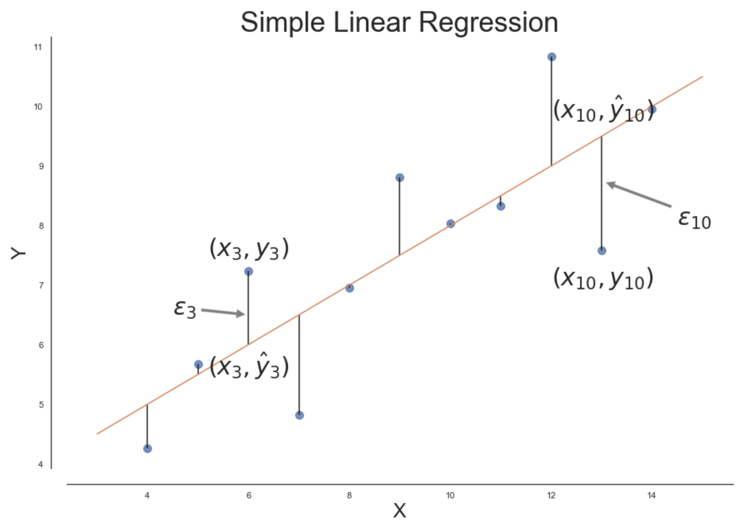
Lesson 1: Regression Evaluation
Evaluation Metrics for Regression
Mean Absolute Error (MAE)
Mean Squared Error (MSE)
Root Mean Squared Error (RMSE)
R-squared ( 𝑅2 )

Slide 7
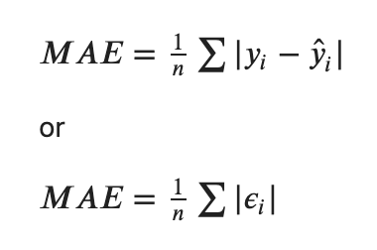
Mean Absolute Error (MAE)

Slide 8
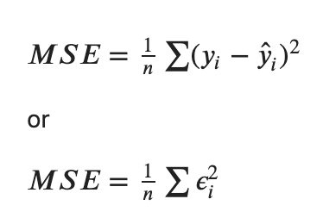
Mean Squared Error (MSE)

Slide 9
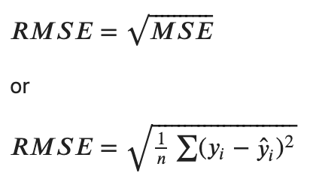
Root Mean Squared Error (RMSE)

Slide 10
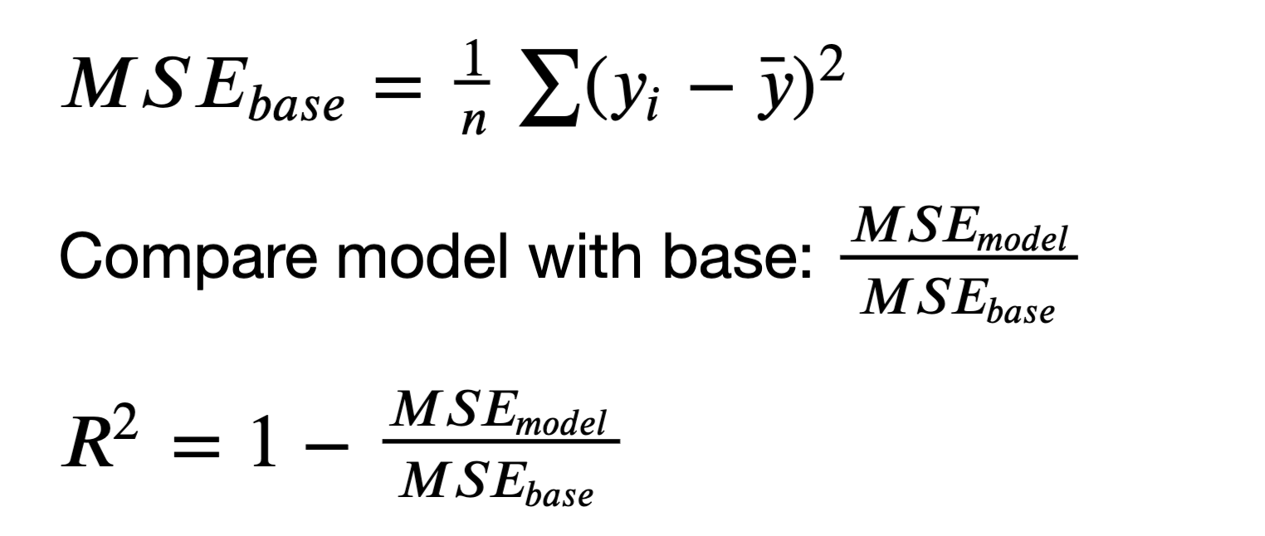
R Squared

Slide 11
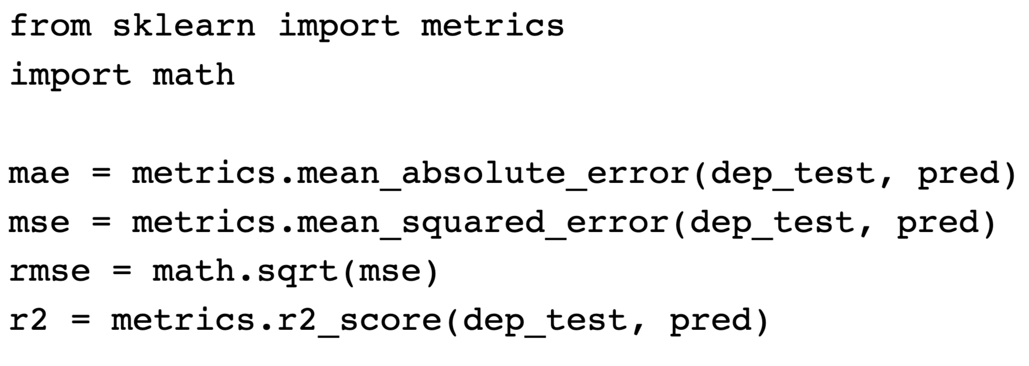
Regression Metric Calculation

Slide 12
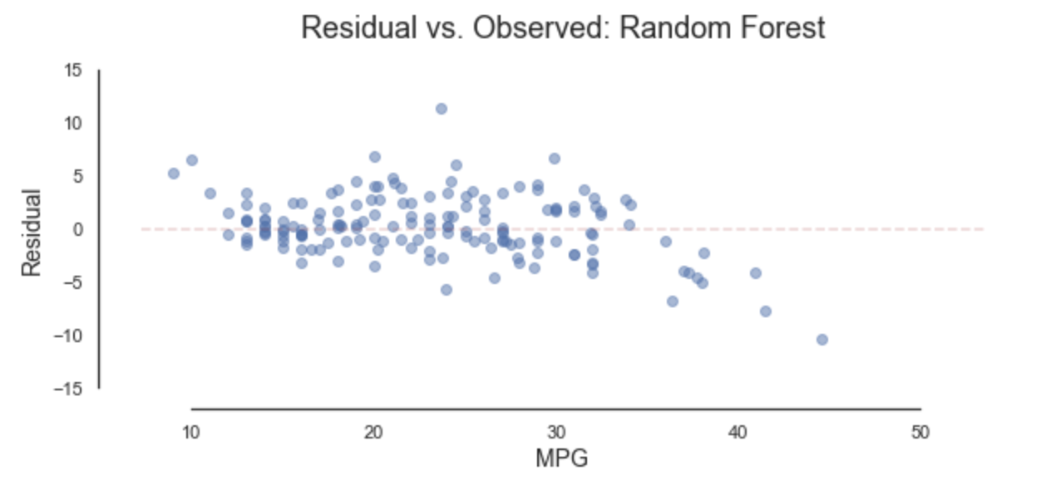
Residual vs. Observed Plot

Slide 13
Classification Evaluation Metrics I
Linden Lu

Slide 14
Classification Evaluation Metrics
Accuracy Score
Classification Report
Confusion Matrix

Slide 15
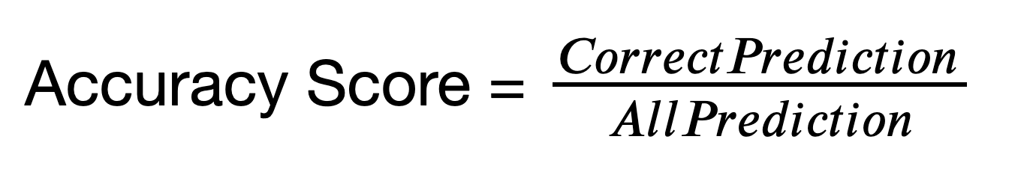
Accuracy Score

Slide 16
Imbalanced Dataset
Cancer screening test dataset
99% negative
1% positive
Zero model accuracy: 99%

Slide 17
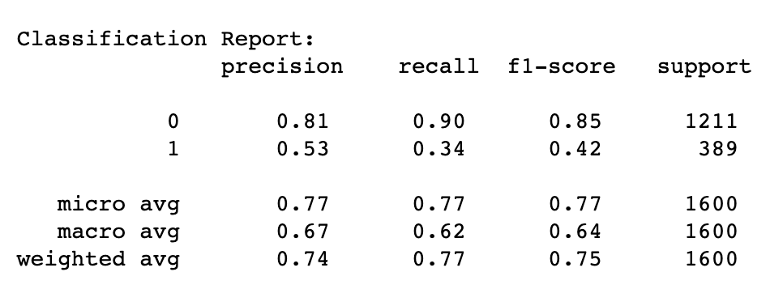
Classification Report
Precision: The proportion of the prediction that is correct.
Recall: Proportion of actual class that is predicted correctly.

Slide 18
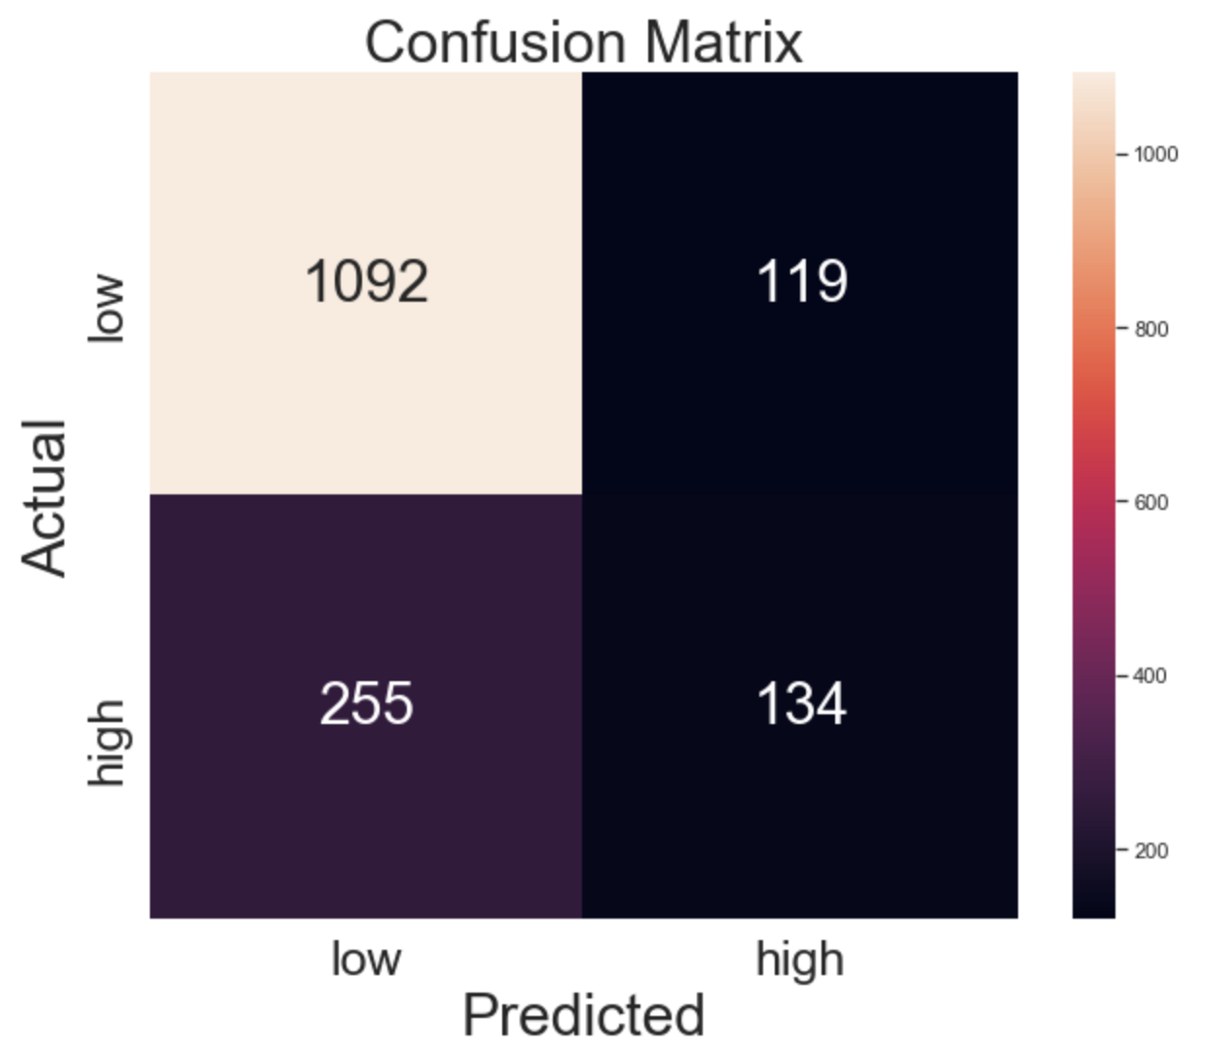
Confusion Matrix

Slide 19
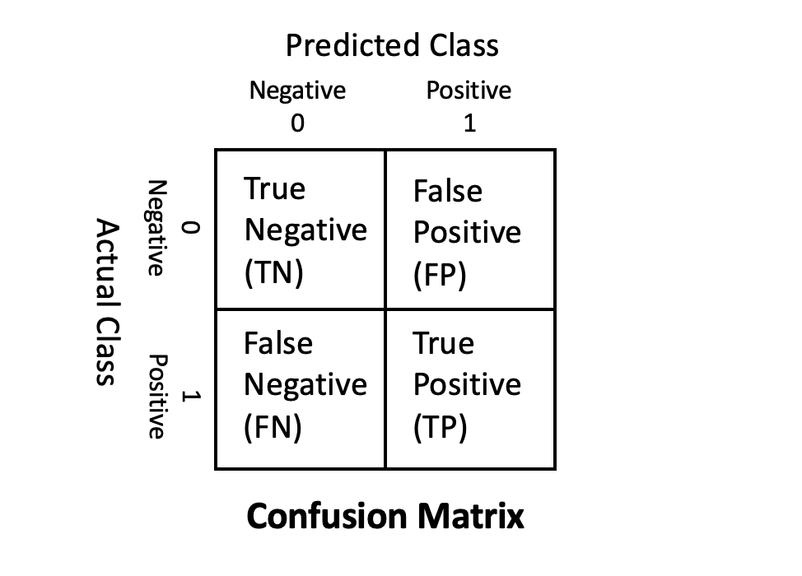
Confusion Matrix
True Negative (TN)
Total number of predicted negatives that are actually negative.
False Negative (FN) aka Type 2 Error
Total number of predicted negatives that are actually positive.
True Positive (TP)
Total number of predicted positives that are actually positive.
False Positive (FP) aka Type 1 Error
Total number of predicted positives that are actually negative.

Slide 20
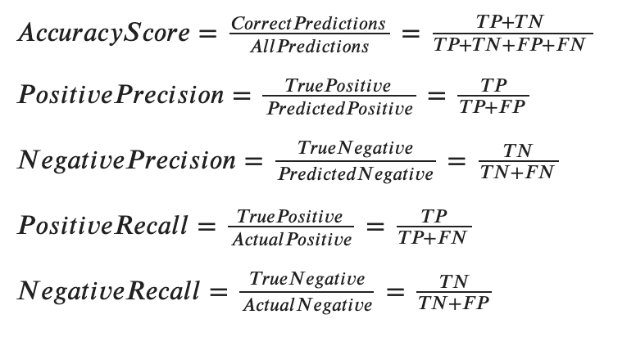
Metrics Calculation

Slide 21
Type 1 and Type 2 Error
When to Avoid Type 1 Error(False Positive)
Criminal trial
When to Avoid Type 2 Error(False Negative)
Cancer screening test

Slide 22
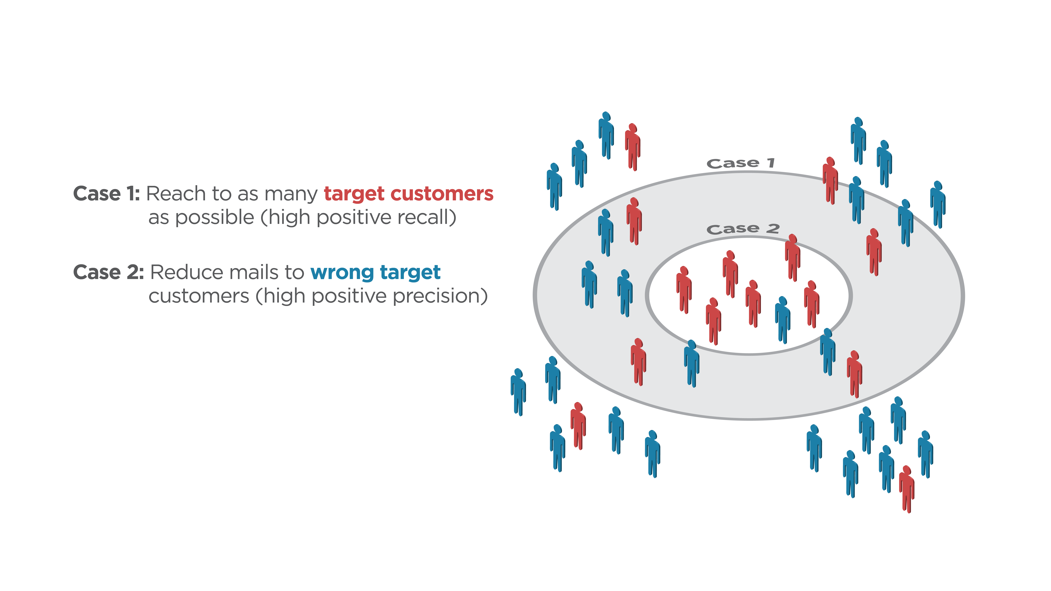
Classification Case Study: Direct Mail Marketing
Case 1: Reach to as many target customers as possible(high positive recall)
Case 2: Reduce mails to wrong target customers(high positive precision

Slide 23
Adjust class_weight Hyperparamter
class_weight
None(default):
Give all classes same weight
Balanced
Give weights inversely proportional to class frequencies
custom weight
class_weight = {0:0.8, 1:0.2}

Slide 24
Classification Case Study: Direct Mail Marketing
Case 1: Reach to as many target customers as possible(high positive recall)
Case 2: Reduce mails to wrong target customers(high positive precision
Case 1: class_weight = {0:0.25, 1:0.75}
Case 2: class_weight = {0:0.8, 1:0.2}

Slide 25
Classification Evaluation Metrics I
Linden Lu

Slide 26
Lesson 3: Classification Evaluation II
ROC
Receiver operating characteristic
AUC
Area under curve

Slide 27
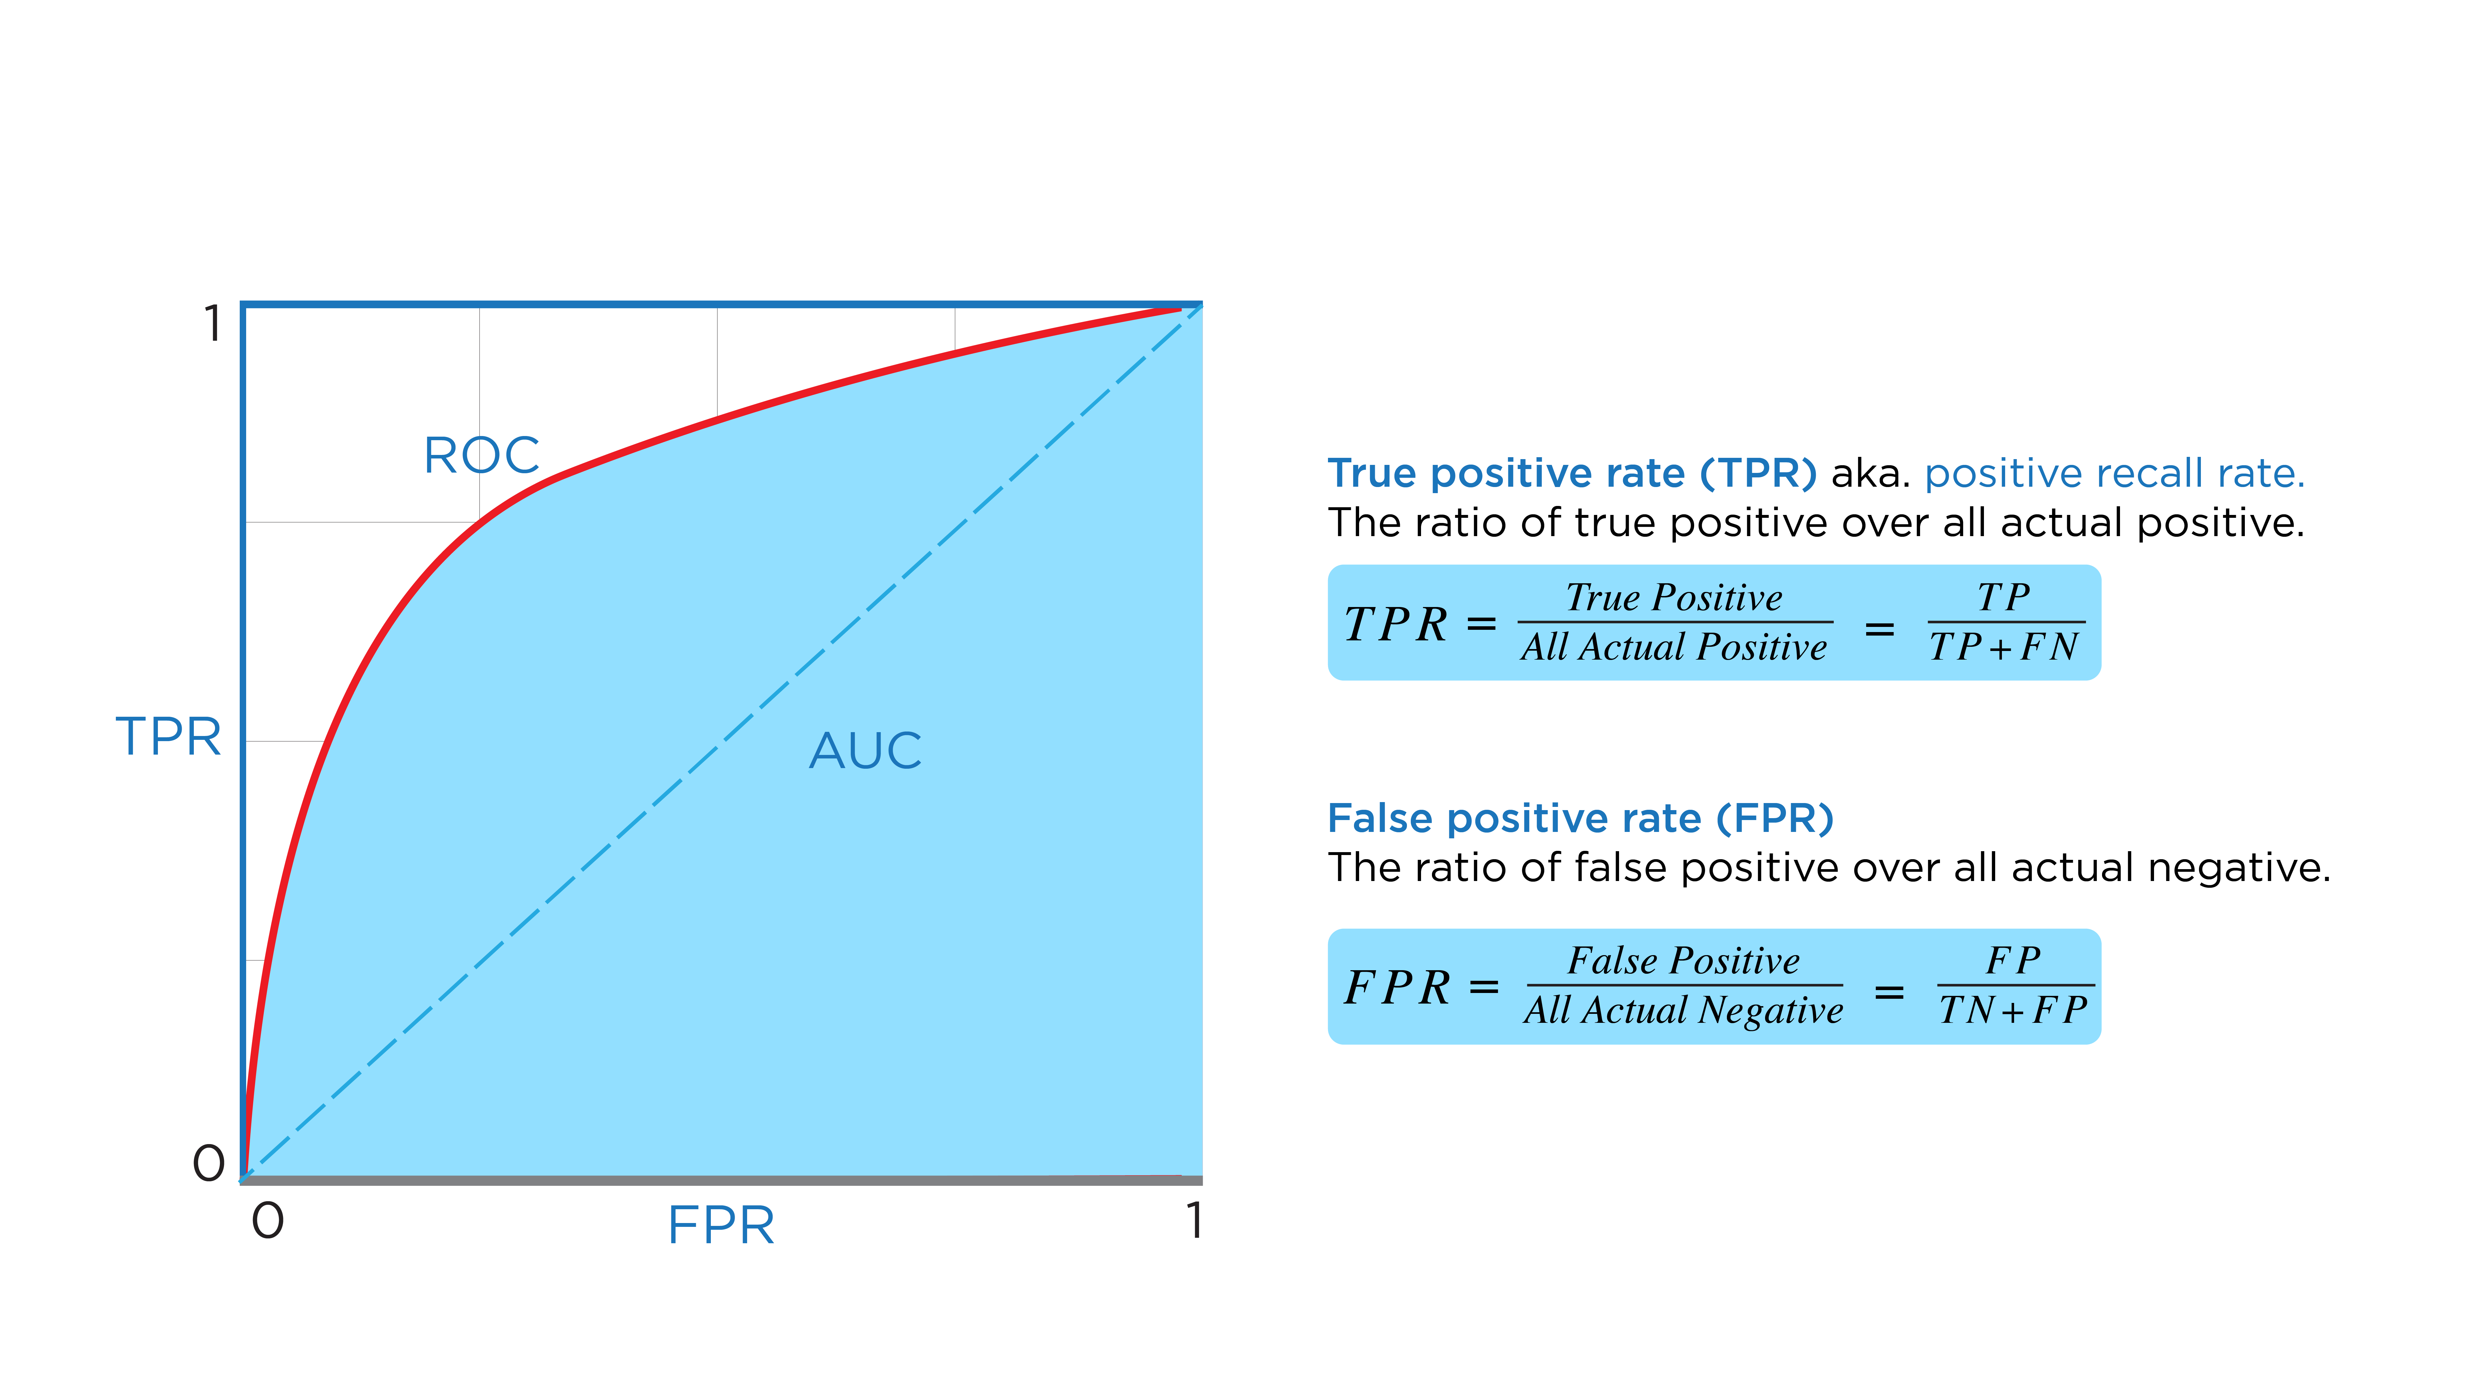
ROC & AUC

Slide 28
Plot ROC
Classifiers that have decision_function():
Logistic Regression
Support Vector Machine
Classifiers that have predict_proba():
K-nearest Neighbors
Decision Tree
Random Forest

Slide 29
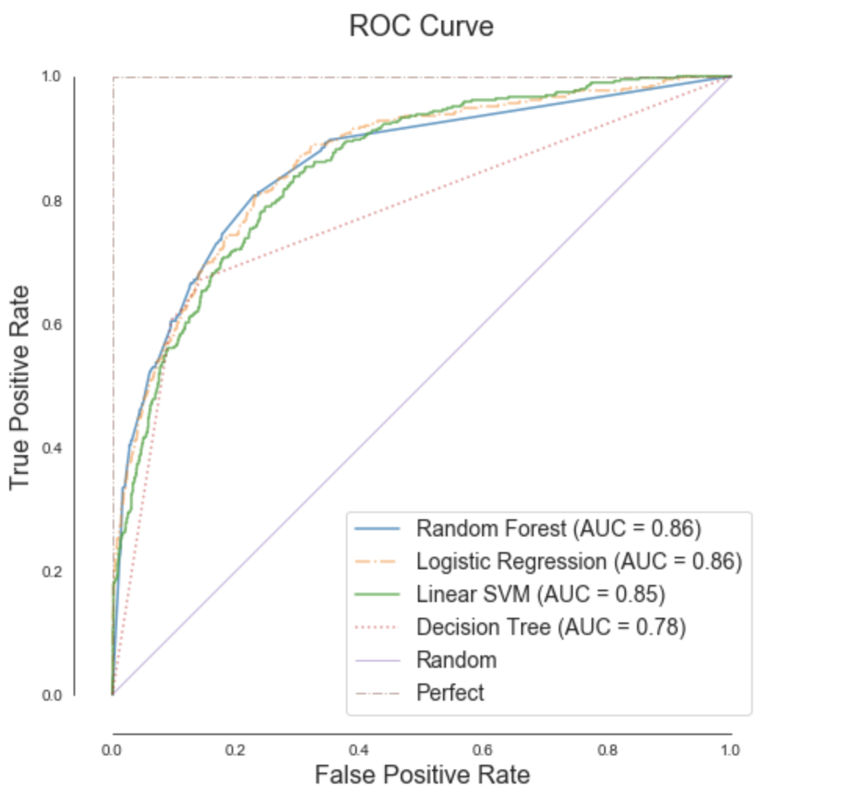
Compare Models with ROC&AUC

